Slide 1
NYS REGENTS Scores from 2014-2019
Jack Robbins

Slide 2
Contents
What are the NYS REGENTS?
Data used in this project
Identifying our response & predictor(s) for regression
Cleaning & preprocessing the data
Visualizing relationships
Building our regression model with backwards selection
Making a prediction with the model
Scoring the model
Conclusion

Slide 3

What are the NYS REGENTS exams?
Exams given to students grades 7-12 in New York State
Subjects like math, science, history, and literature
Used by the state to evaluate learning outcomes

Slide 4
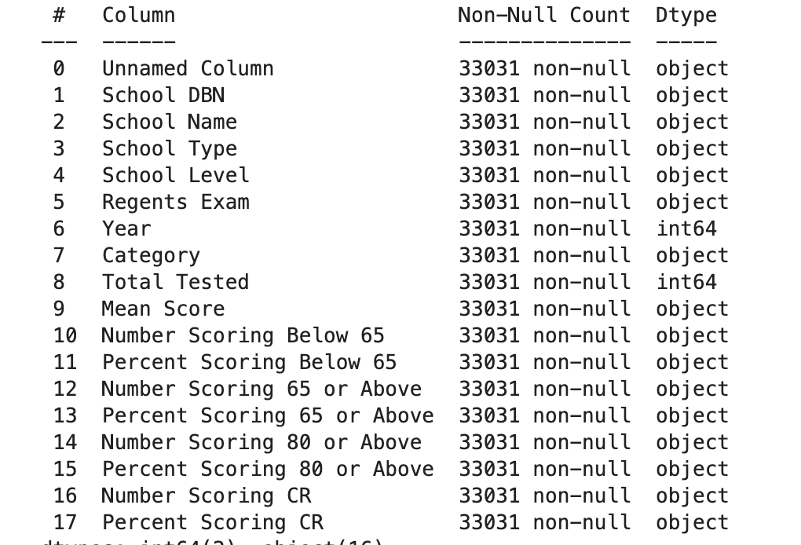
Data Used in this Project
Data used is from NYC for years 2014-2019
https://data.cityofnewyork.us/Education/2014-15-to-2017-19-NYC-Regents-Exam-Results-Public/bnea-fu3k/about_data
Contains several categorical and numerical columns, many of which are related to each other
Contains many columns with bad values, irrelevant columns
and things that will need to be cleaned

Slide 5
Identifying Response & Predictor Variables
Response: Percent of students who score 80 or above in the school
Percent over number of students because number is heavily influenced by school size
Predictors: I suspected that these would influence the percent who score 80 or above
School Type
School Level
REGENTS Exam
Year
Category
Total Tested
Mean Score

Slide 6
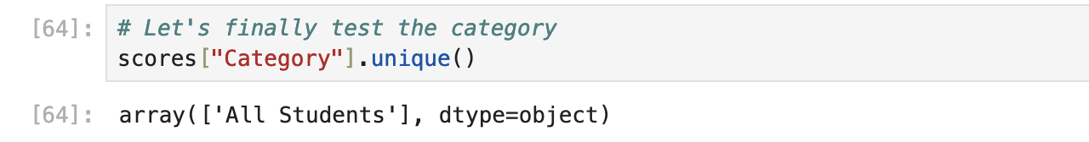
Cleaning & Preprocessing the data
Steps taken:
Remove all columns that are not response or predictor
Dropping rows where less than 10 students took a given exam
Dropping rows with ‘ungraded’ values in school level
Removing the entire category column, because it only ever had one value
Checked for and removed all ‘na’ values
Encoding categorical data like “School Type” using LabelEncoder

Slide 7
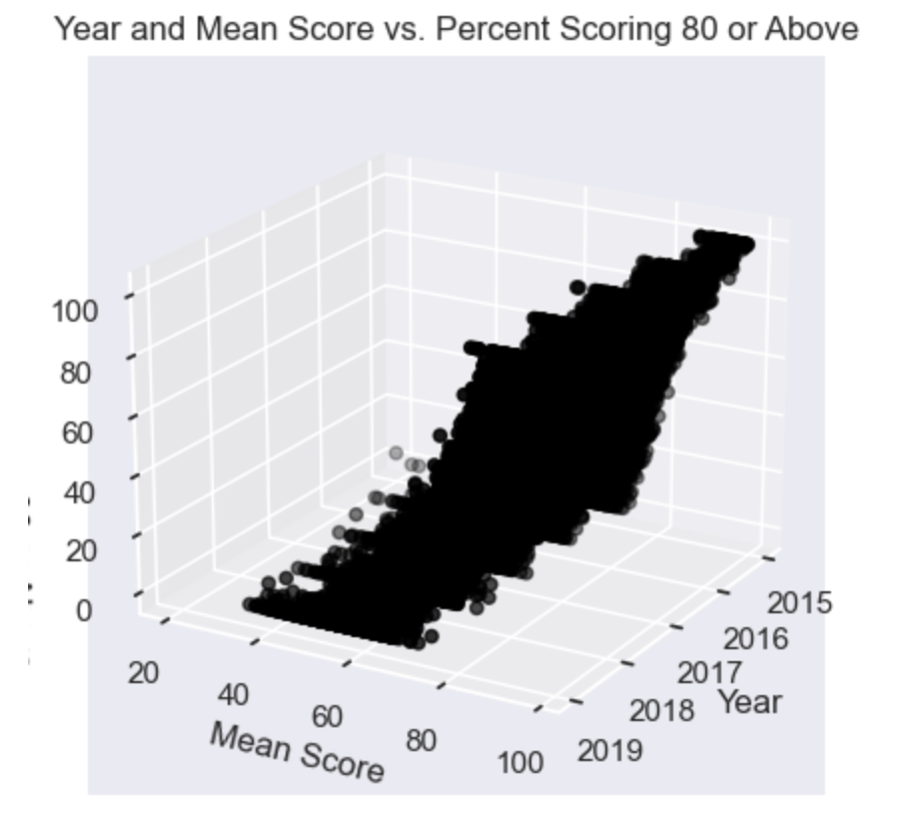
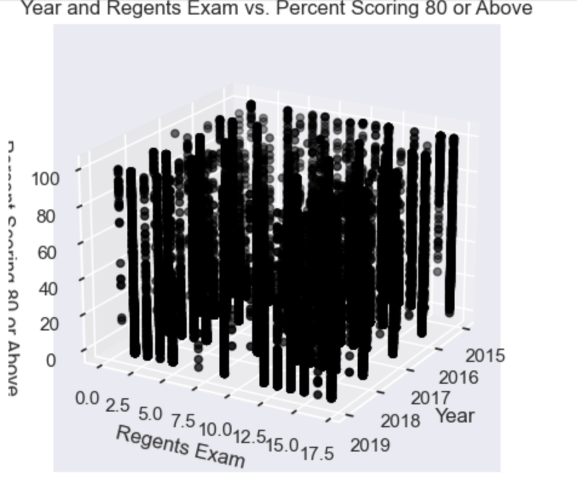
Visualizing Relationships

Slide 8
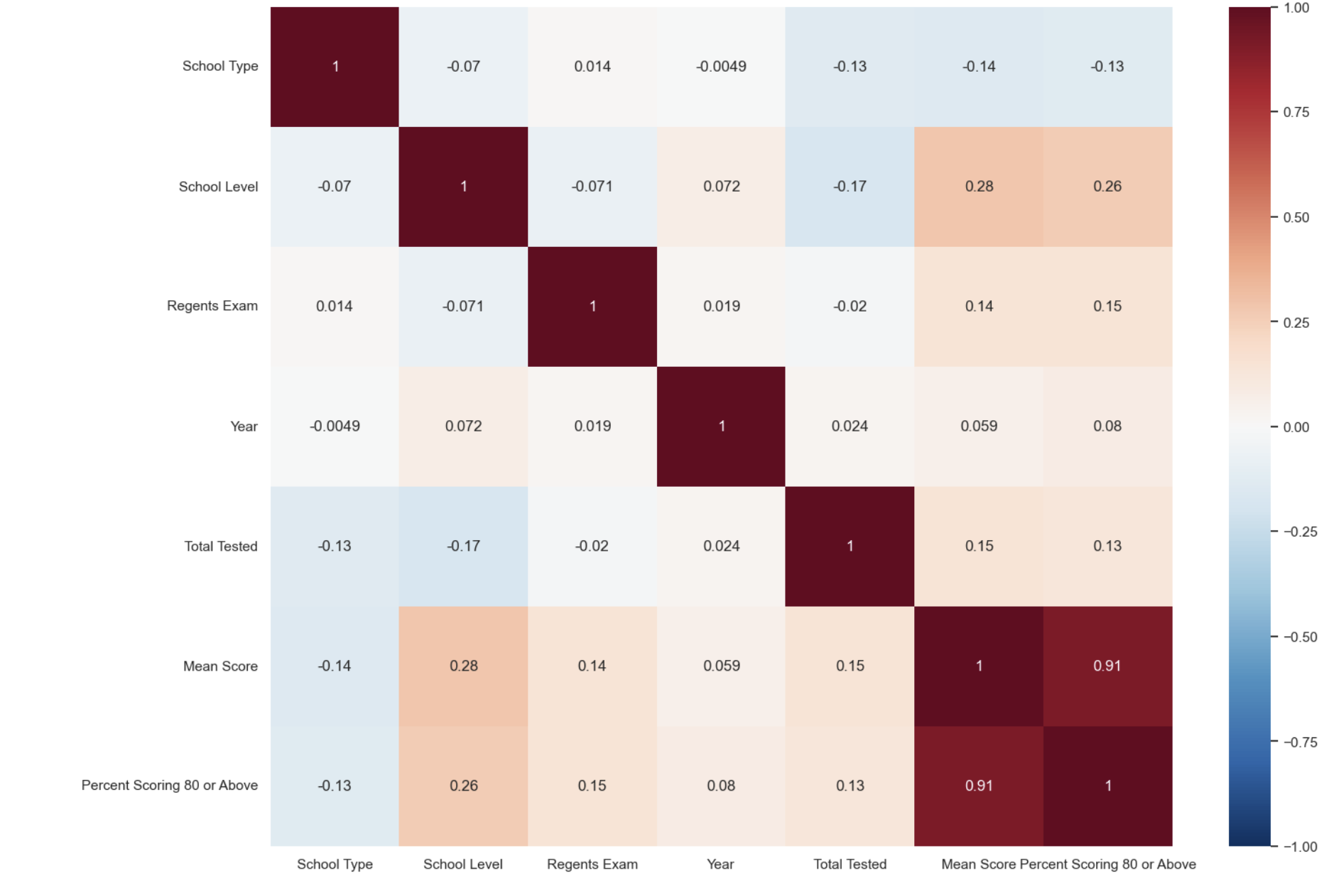
Visualizing Relationships

Slide 9
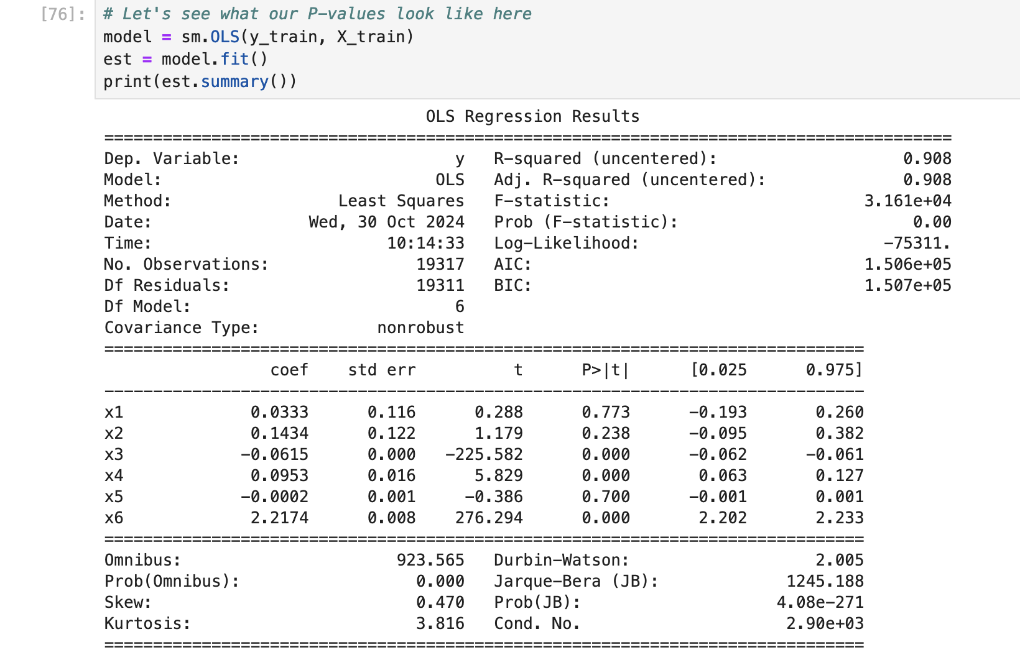
Fitting our model using backwards selection

Slide 10
Fitting our model using backwards selection
Repeat this process until all P-values are significant
Eventually left only with Year, Regents Exam and mean score as our final 3 predictors

Slide 11
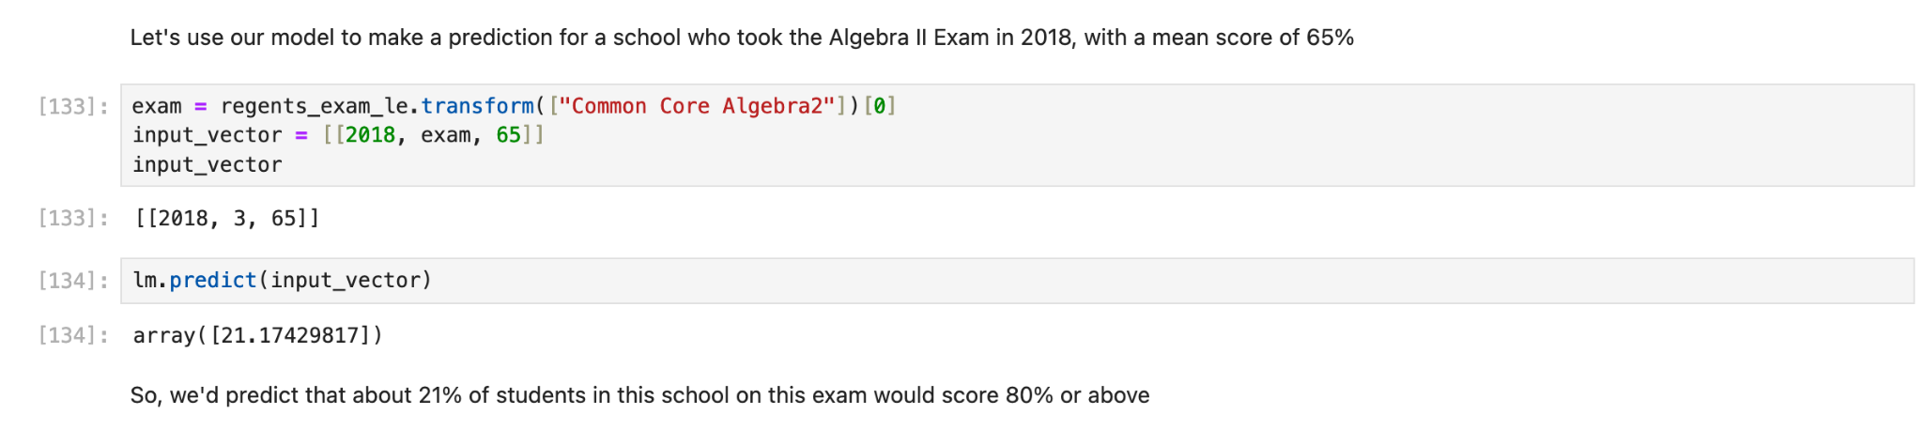
Example Prediction

Slide 12
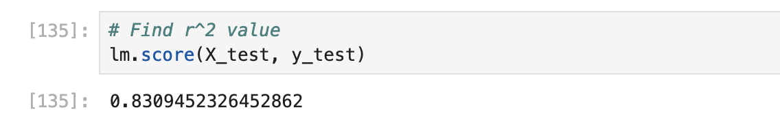
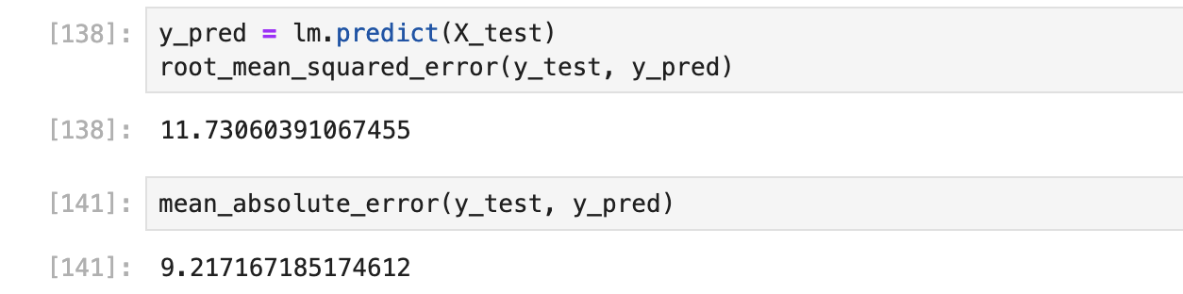
Scoring the model

Slide 13
Conclusions

